Slide 1

Spread trading strategies in the crude oil futures market
Professor: Totouom Tangho, Daniel H
Yipei Zhang, yz4369@nyu.edu

Slide 2
Commodities
WTI : West Texas Intermediate (WTI) crude oil is a specific grade of crude oil
Brent : Brent Crude may refer to any or all of the components of the Brent Complex, a physically and financially traded oil market based around the North Sea of Northwest Europe
* Source: https://www.wikipedia.com

Slide 3
What is difference between Brent and WTI?
In the United States, West Texas Intermediate is the preferred measure and pricing model. It is also slightly "sweeter" and "lighter" than Brent. West Texas Intermediate (WTI) is slightly lower in price than Brent.
If these two commodities has some cointegration relationship, then we can set up a strategy.

Slide 4
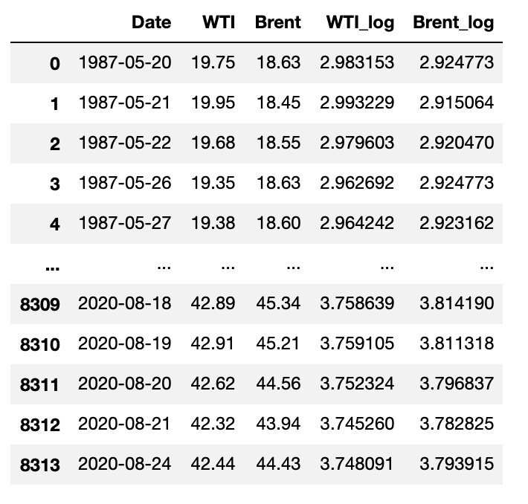
Dataset
Close price for WTI and Brent from 1987-05-20 to 2020-08-24.
Downloaded from Quandl.

Slide 5
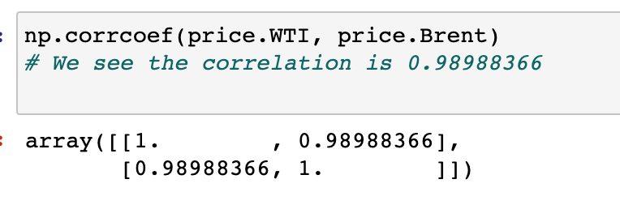
Can we do?
From the article, “if the price series of WTI and Brent are cointegrated, then there exists a linear combination of both series that is stationary. ”
The Brent and WTI are highly correlated, which is consistent with the statement in the article
Therefore, we could be able to do the hedging trading strategy based on these two commodities

Slide 6
Idea of the strategy
A pairs trade is a trading strategy that involves matching a long position with a short position in two stocks with a high correlation.
The question is what ratio should we implement for the trading.
* Source: https://www.investopedia.com

Slide 7
Trading strategies
Hedging using static ratio
The hedge ratio is estimated by using the WTI and Brent prices of the last year before the test period starts and is not changed over the course of the test period
Hedging using dynamic ratio
dynamic linear model with Kalman filtering and maximum likelihood estimates of the unknown variance of the state equation is employed to constantly update the hedge ratio of the portfolio.

Slide 8
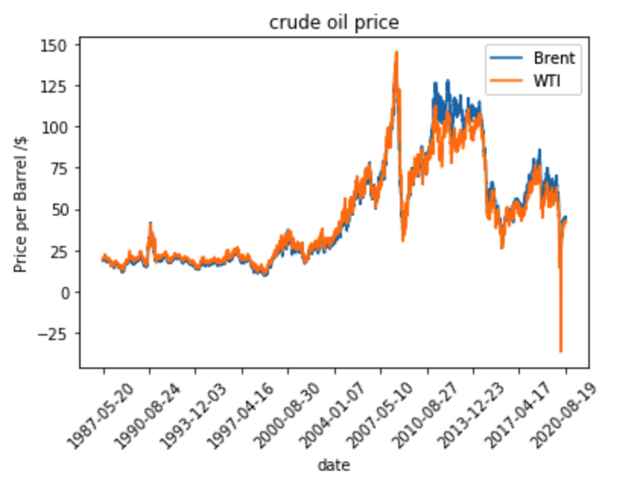

Slide 9
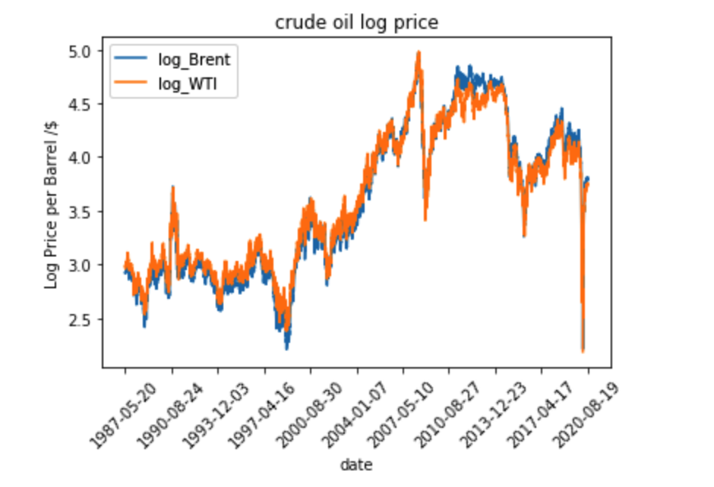
For the trading strategies, I use log price

Slide 10
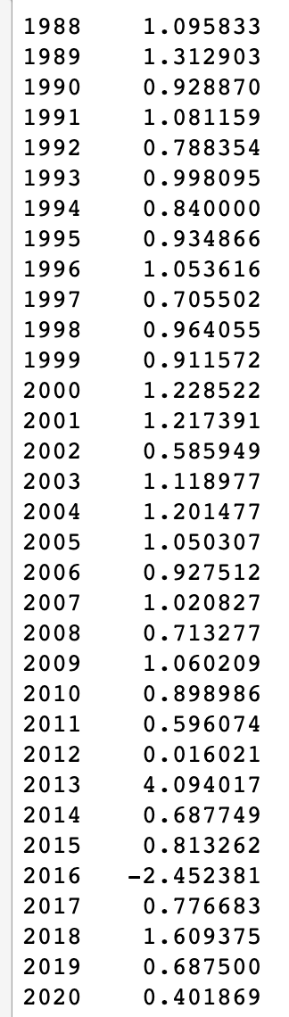
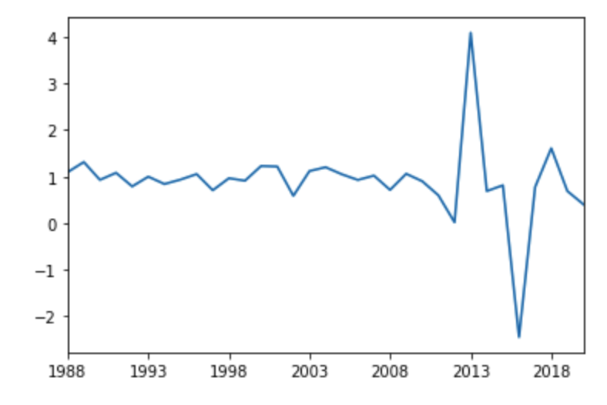
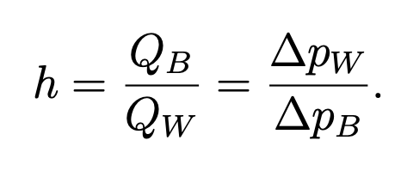
The equation
According to the article, we use last year’s ratio for this year’s price to implement the strategy.
* Source: Spread trading strategies in the crude oil futures market

Slide 11
Dynamic Hedging Ratio for Mean-Reverting Strategies
To compute the dynamic hedging ratio, we could use KalmanFilter to do the regression to find out the hedging ratio.

Slide 12
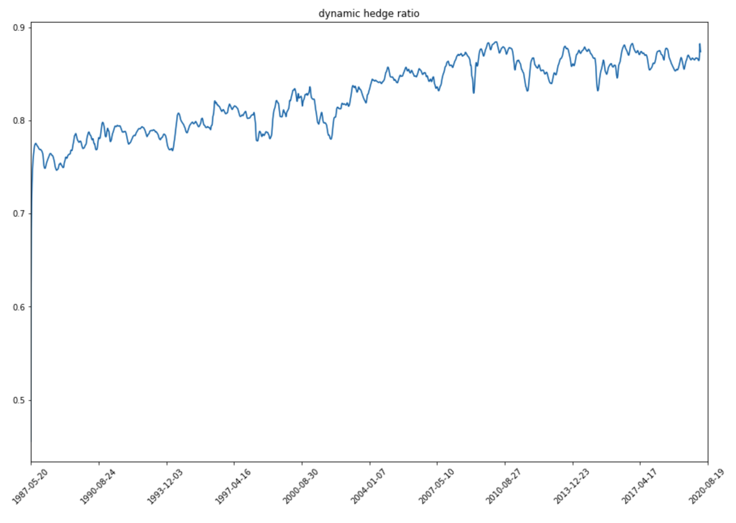

Slide 13
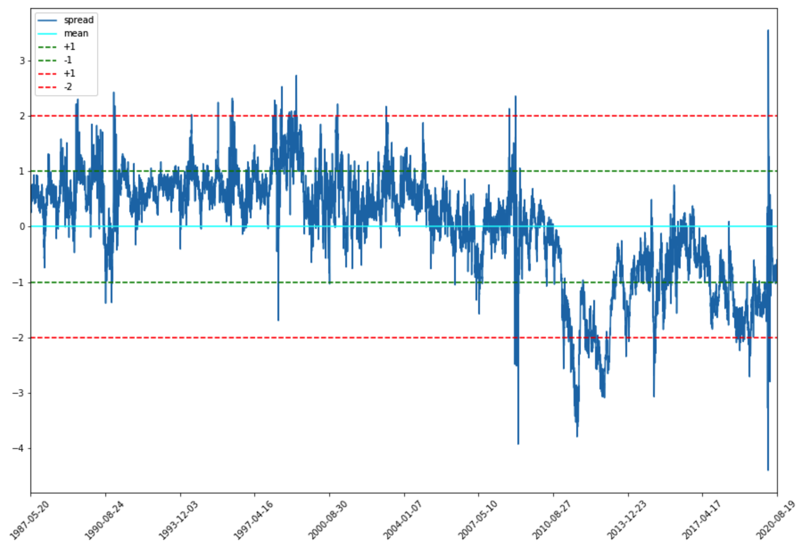

Slide 14
Strategy
When abs(spread) > abs(2 * std), Open position
When abs(spread) = 0 * std, Close the position
Loss exit: abs(spread) > x * std, Close the position

Slide 15
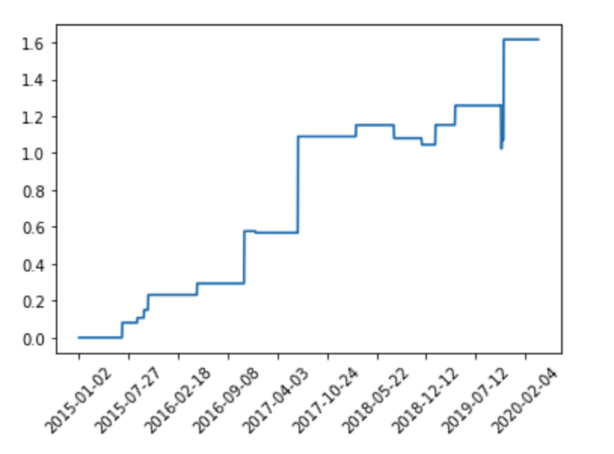
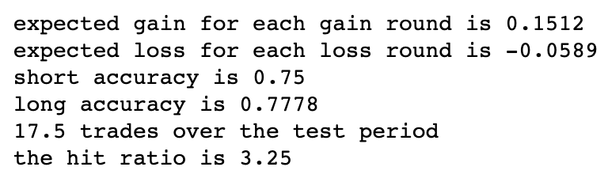
Static hedging ratio
From 2015 to 2020

Slide 16
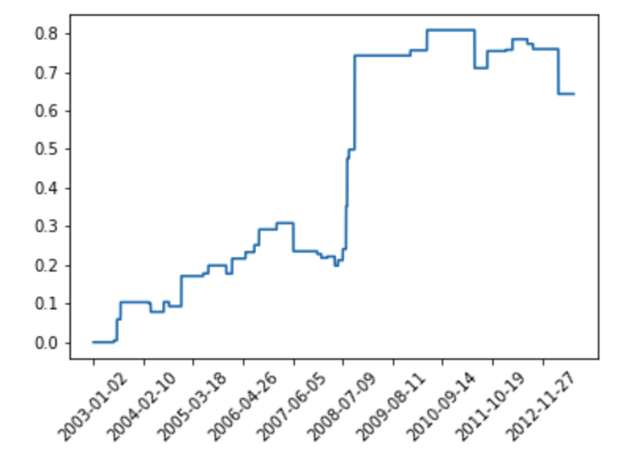
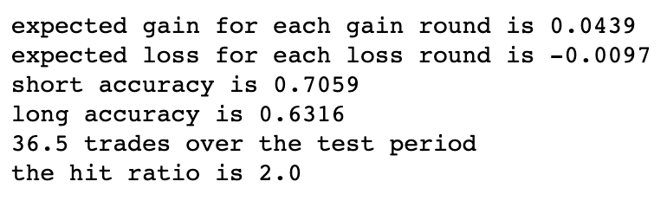
Static hedging ratio
From 2003 to 2013

Slide 17
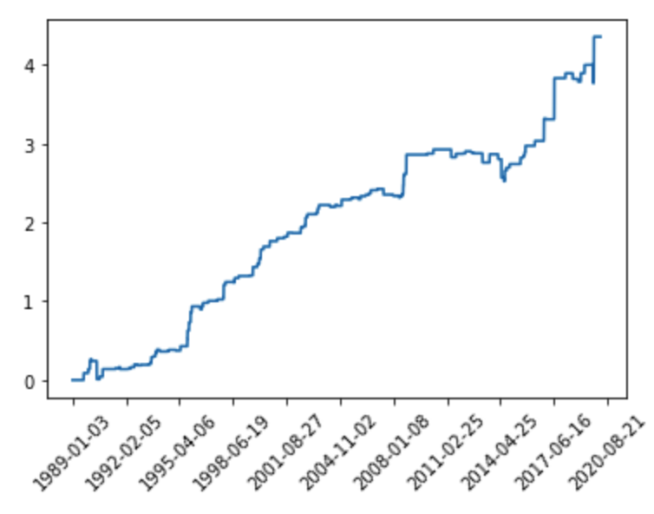
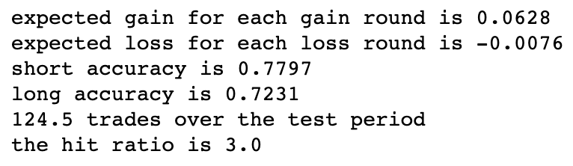
Static ratio
The whole time period

Slide 18
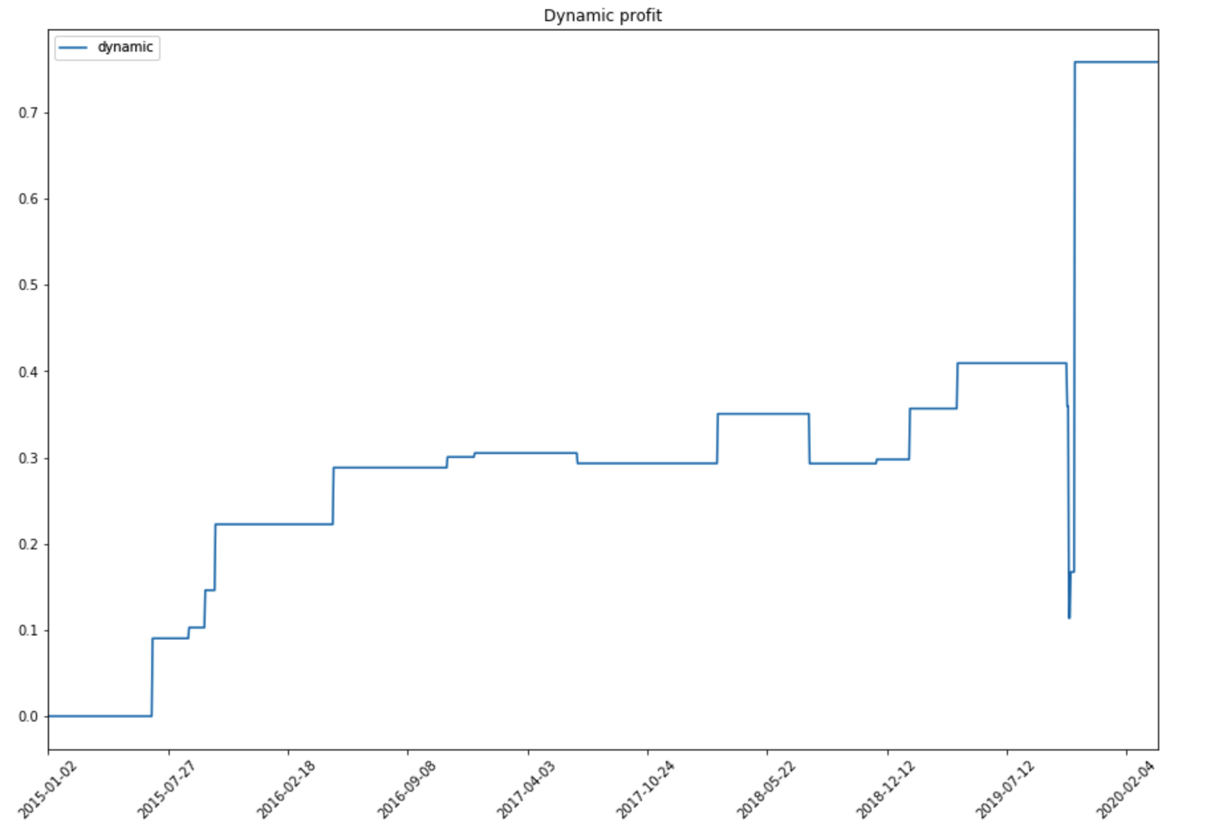
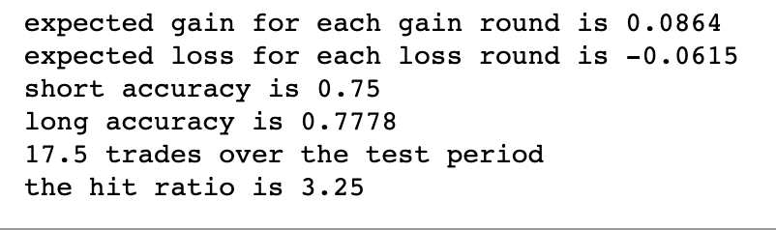
Dynamic hedging ratio
From 2015 to 2020

Slide 19
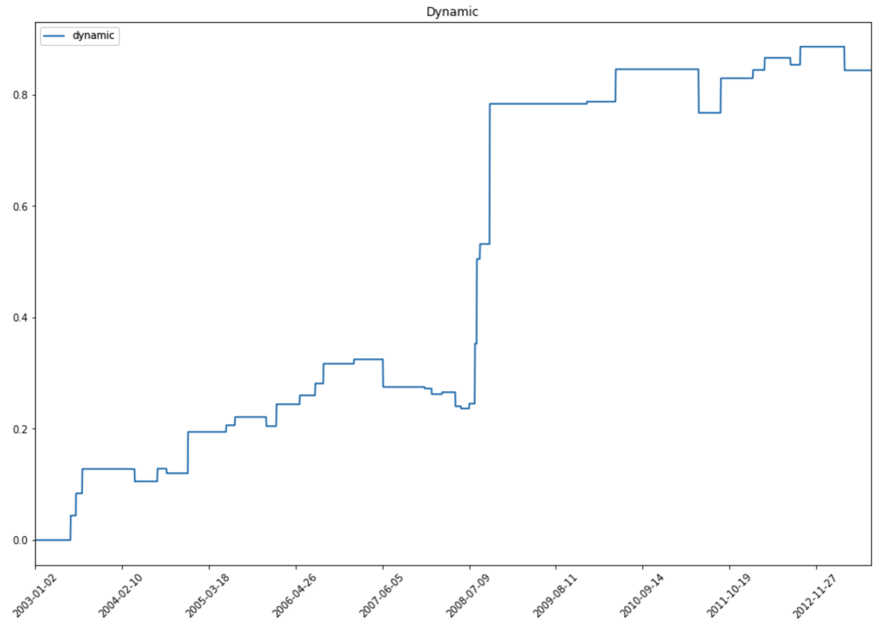
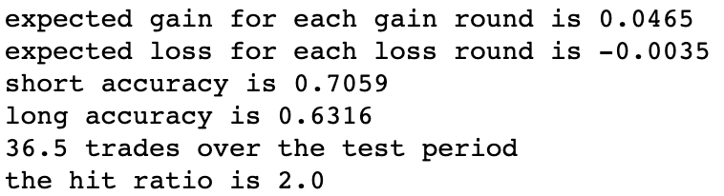
Dynamic hedging ratio
From 2003 to 2013

Slide 20
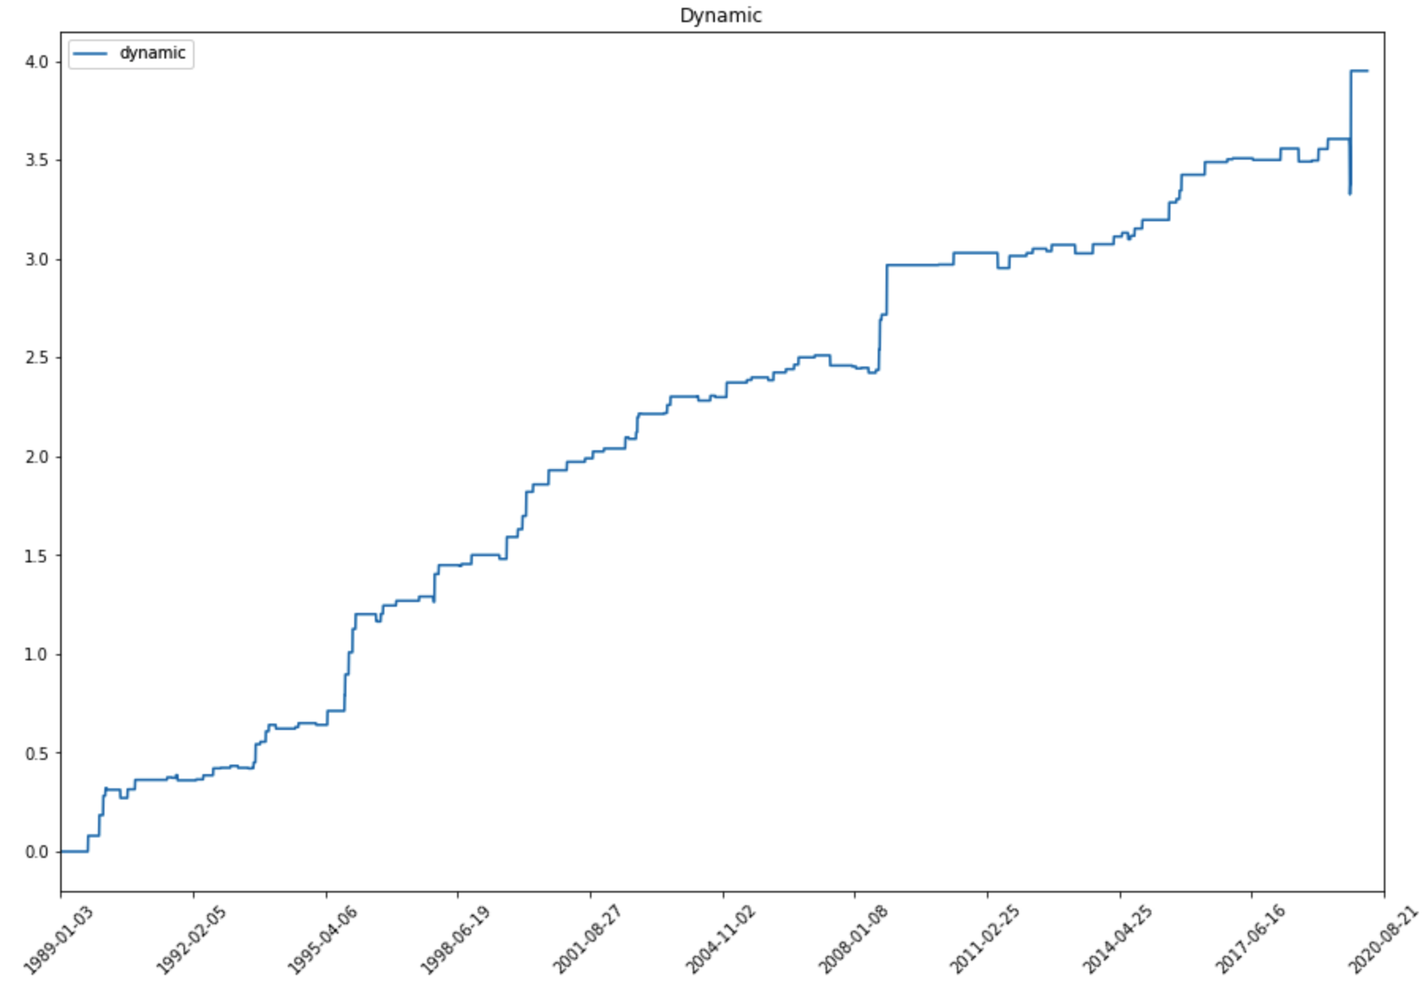
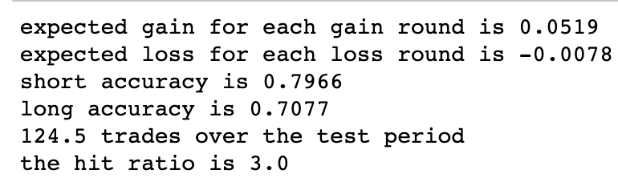
Dynamic ratio
The whole time period

Slide 21
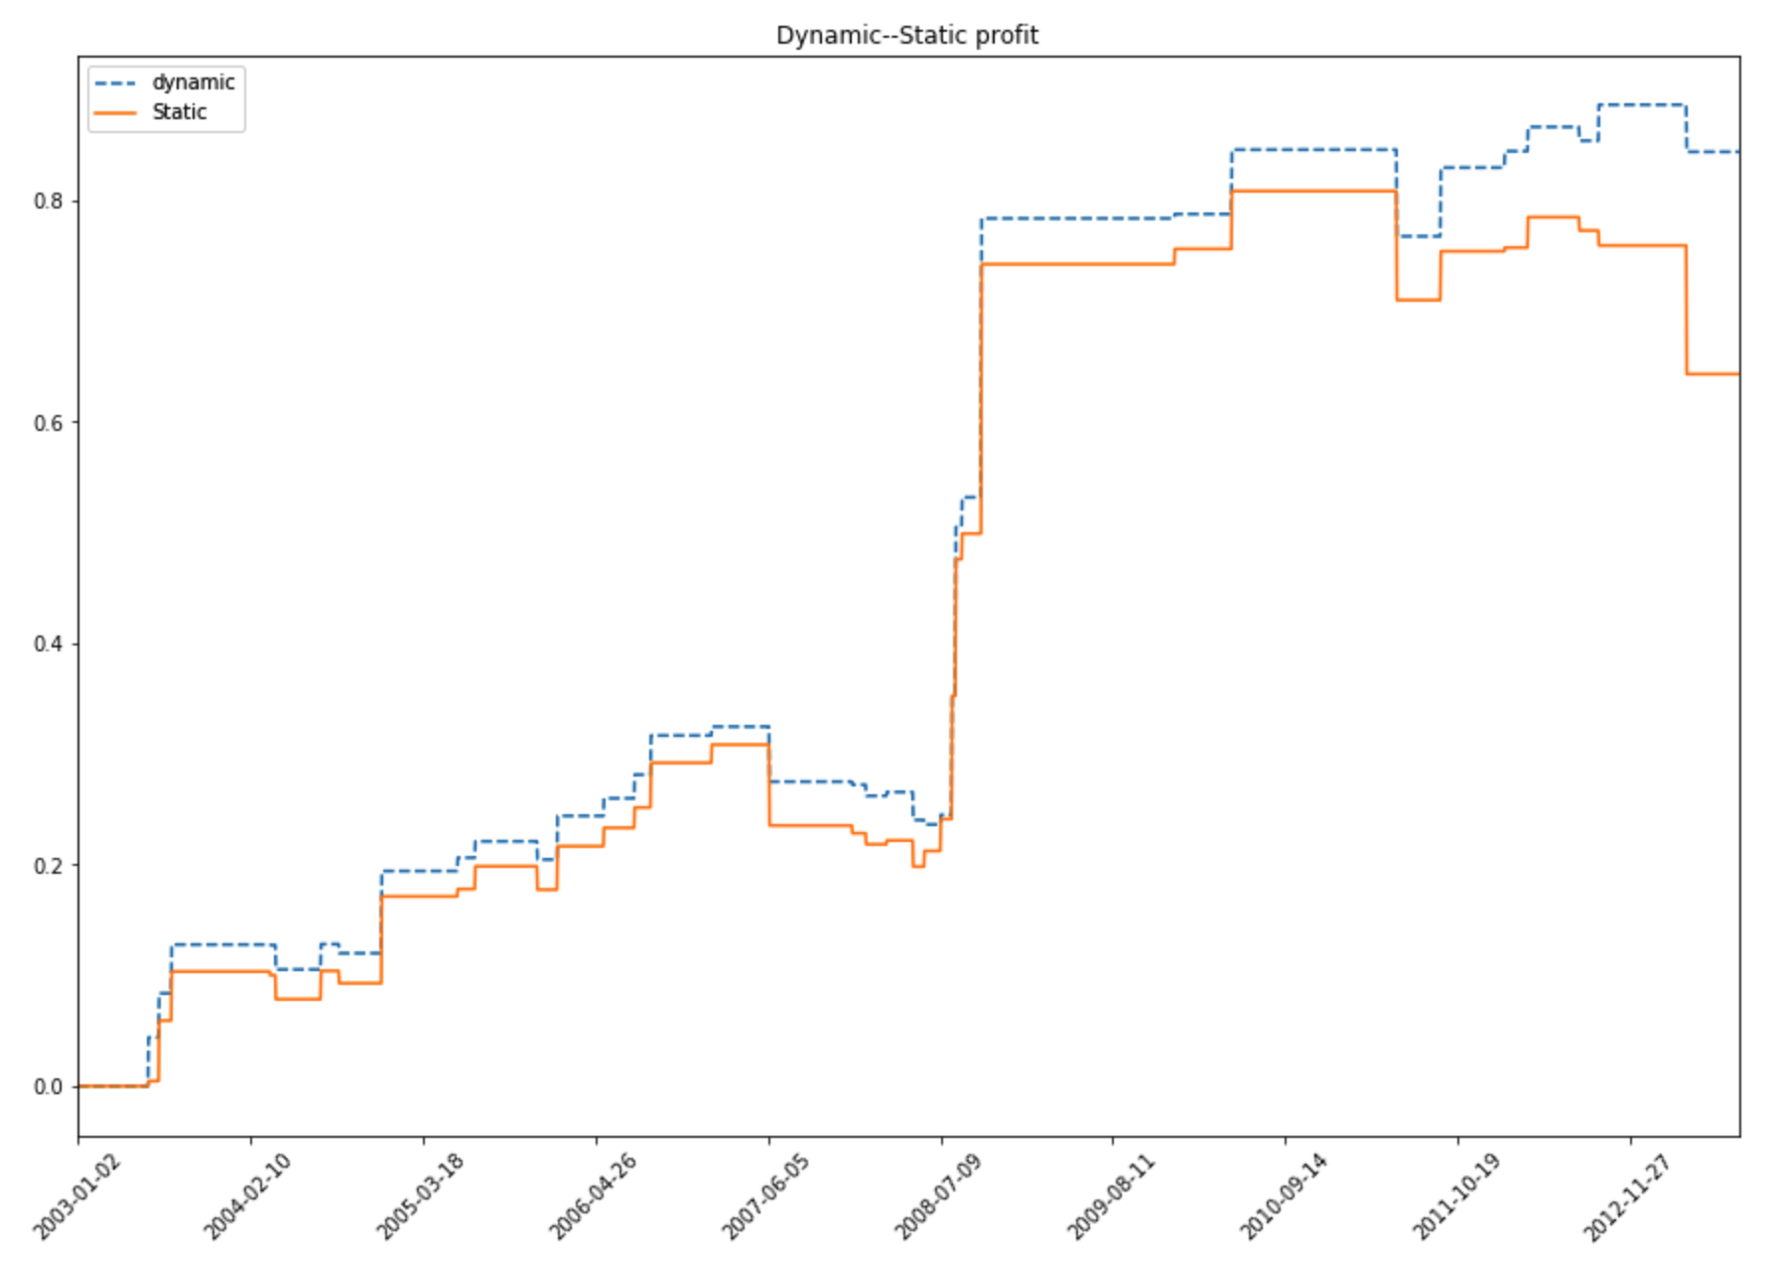
2003 to 2013
Dynamic ratio strategy performs better

Slide 22
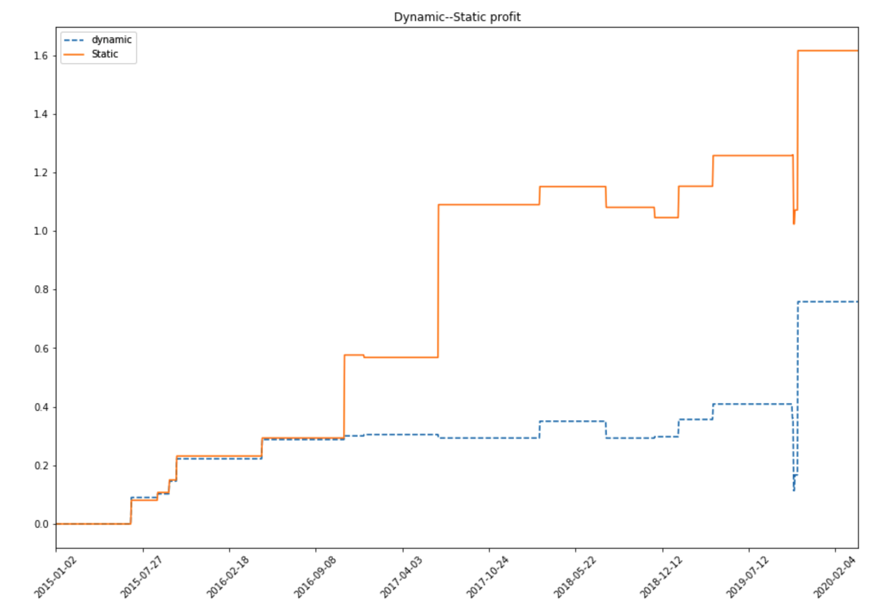
2015 to 2020
The Static strategy performs better

Slide 23
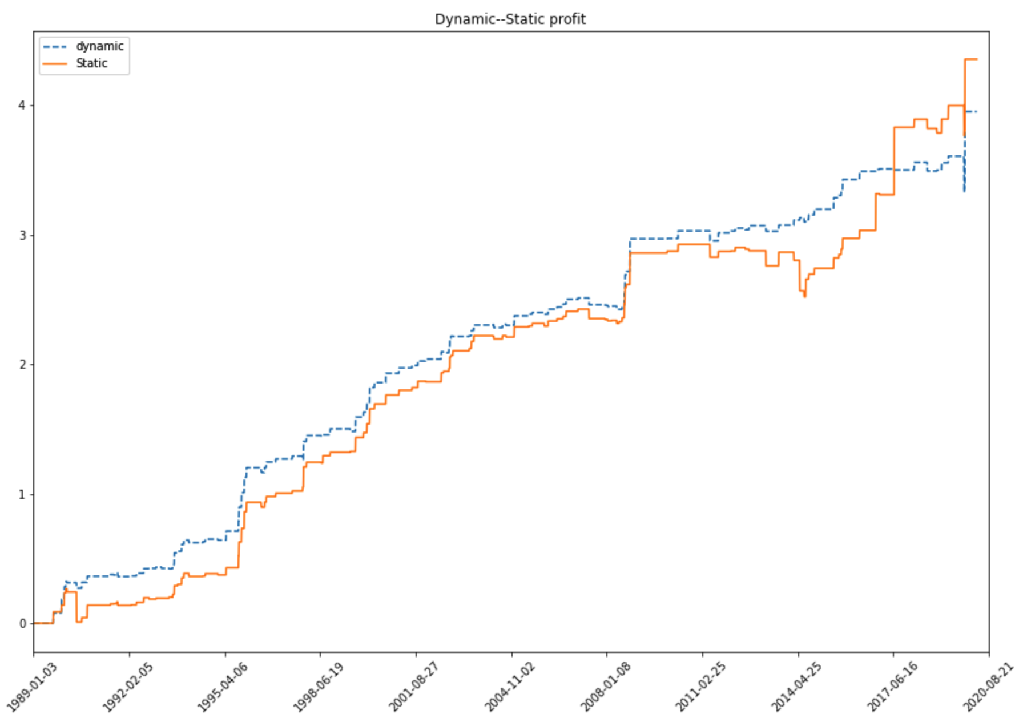
Whole time period
The static ratio performs better at the end
But dynamic ratio strategy performs better for the most of time

Slide 24
What if adding Loss exit signal

Slide 25
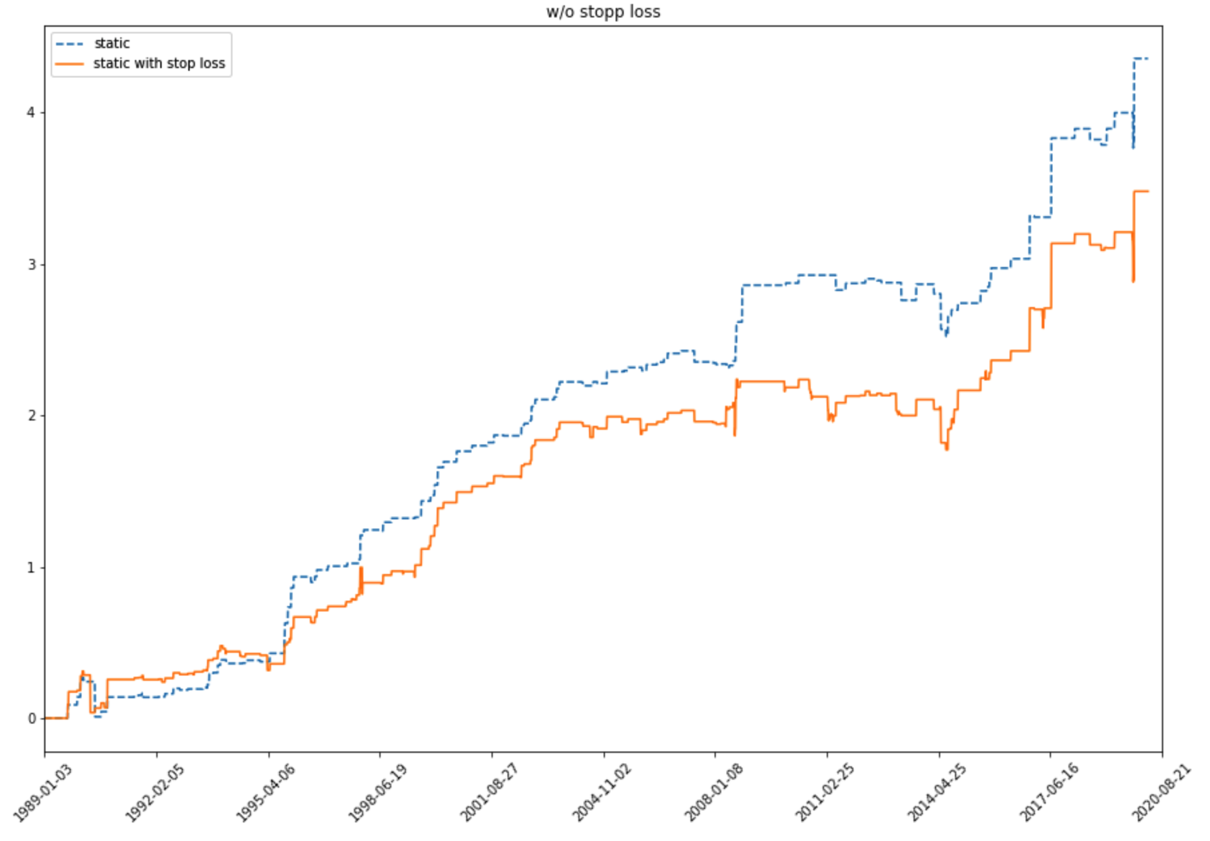
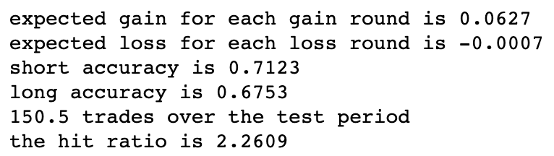
Adding loss exit Static ratio Whole time period
Without loss exit
With loss exit

Slide 26
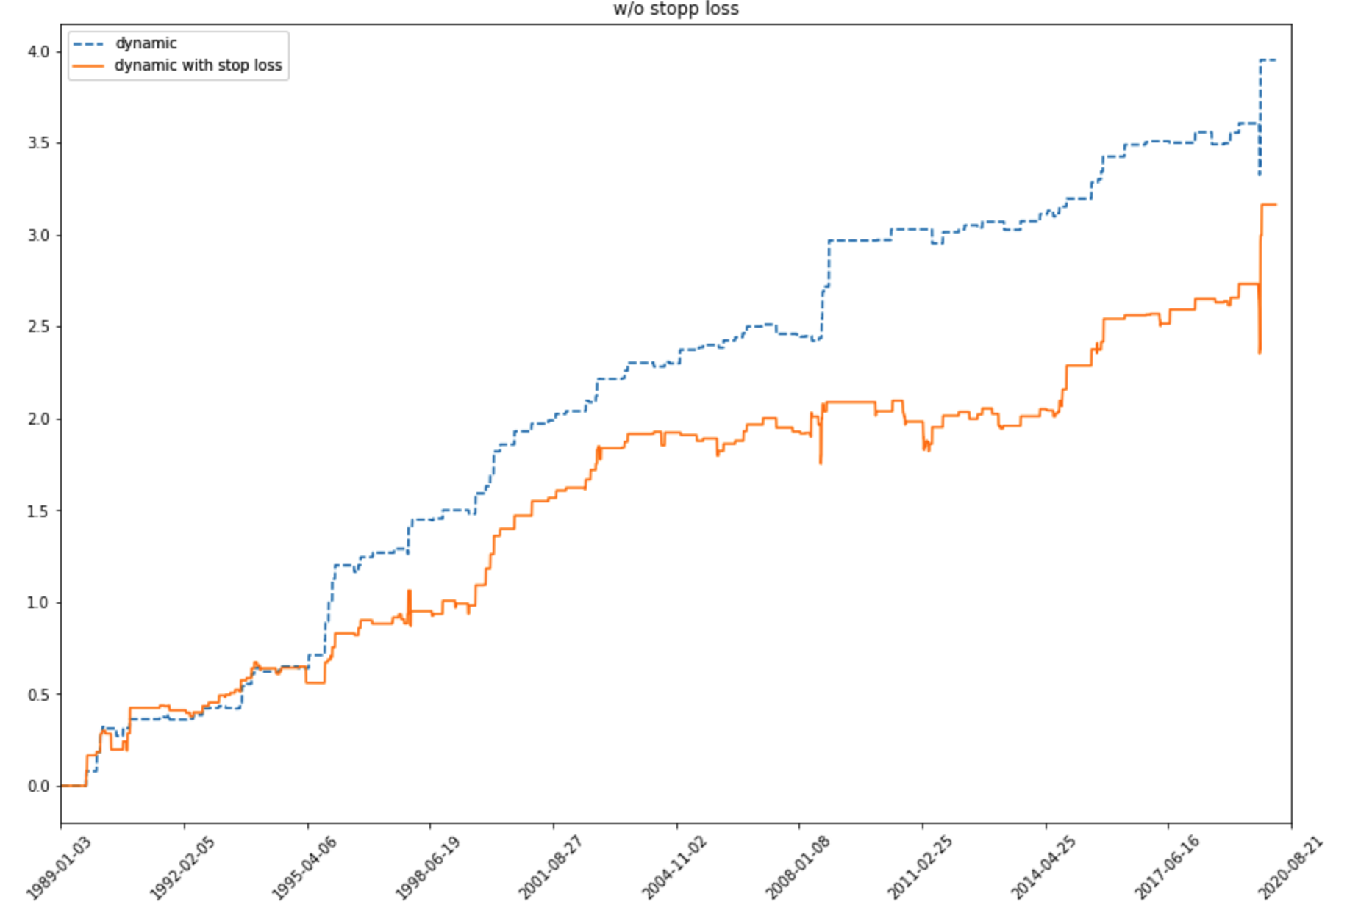
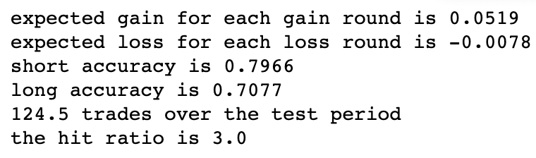
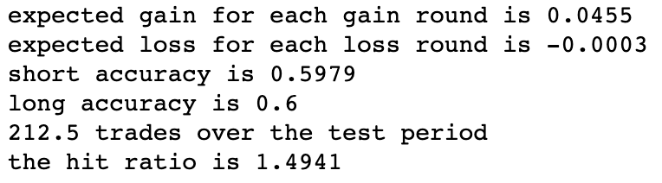
Adding loss exit Dynamic ratio Whole time period
Without loss exit
With loss exit

Slide 27
Possible reason
Loss exit signal forces to close the position when spread is too big.
When closing, the loss is set. Therefore, the profit does not look promising compared with the one without loss exit signal

Slide 28
Further direction
Calculate the half life signal for the mean-reverting process, change the time window.
How settlement price influences the trading profit.
Test how other commodities behave under these trading strategies

